Slide 1

The Health eWorkforce (HeW) Consortium, funded by the Department of Labor, was formed to elevate national Health Information Technology workforce development efforts and train more than 2,000 veterans, TAA-eligible workers and others for promising careers in healthcare and Health IT.
Health eWorkforce Consortium Student Support Staff Meeting
April 23, 2014

Slide 2

Agenda
“Optimism is the faith that leads to achievement. Nothing can be done without hope and confidence.” ~Helen Keller
  Introduction
  Updates on Veteran Recruiting
  Challenges & Best Practices
  LinkedIn HeW Employment Group
  Round of Commitments
  TAA Reminder
  Future Meeting Topics, Facilitators & Guest Speakers

Slide 3
Updates on Veteran Recruiting
  Presence at Joint Base Lewis-McChord Stone Education Center
    Role: Recruiting for HeW Consortium Programs
    Goal: Increase % of service members, veterans, and spouses in the HeW grant programs
    In-Office Hours: Mondays: 9:00am to 3:30pm and Thursdays: 11:00am-3:00pm
    Advising Staff Meetings: Thursdays: 8:30am-11:00am

Slide 4
Updates on Veteran Recruiting
  Process
    Initial point of contact
    Welcome
    Provide Program Information
    Determine Program Interest
    Collect Contact Information
    Record Nature of Contact (Initial, follow-up, handoff, etc.)
    Hand Off to MC Navigators (cc: on response or 3-way call)
    Follow up and Collect Feedback
  Marketing Materials

Slide 5
Discussion
  What are you doing at your colleges to recruit military service members, veterans and spouses?

Slide 6

Challenges & Best Practices

Slide 7
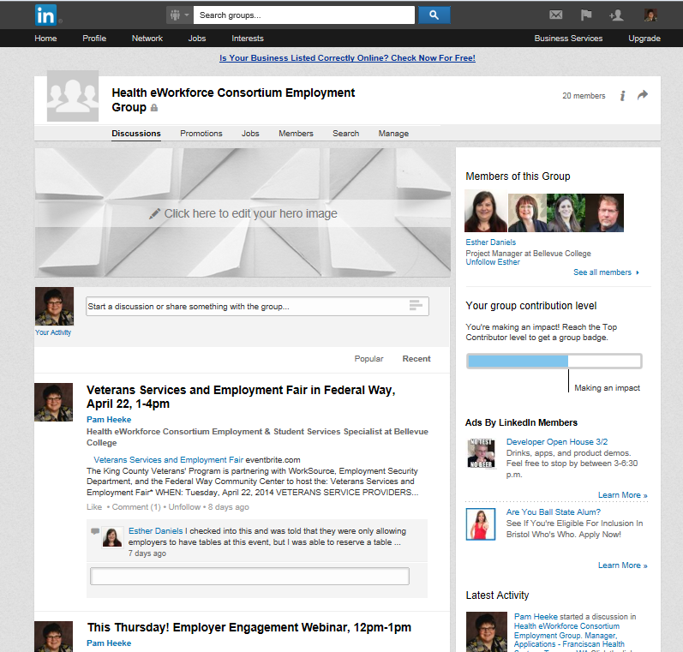

LinkedIn HeW Employment Group
  How is the LinkedIn group working for you?
  What do you want to see there? (ex: resources, internships, jobs, etc.)
  What other support do you want or need in this area?

Slide 8

Round of Commitments
  Name one action item you will be committed to in the next month.

Slide 9
TAA Reminder
  Who has sent Caitlyn Jekel program information for recruiting TAA participants?

Slide 10

Future Meeting Topics, Facilitators & Guest Speakers
  Next Meeting: Wednesday, May 21, 1pm-2pm
  Discuss rotating facilitators
  Suggestions for topics and/or guest speakers?
This workforce solution is 100% funded by an $11.7m grant awarded by the U.S. Department of Labor's Employment and Training Administration. The solution was created by the grantee and does not necessarily reflect the official position of the U.S. Department of Labor. The Department of Labor makes no guarantees, warranties, or assurances of any kind, express or implied, with respect to such information, including any information on linked sites and including, but not limited to, accuracy of the information or its completeness, timeliness, usefulness, adequacy, continued availability or ownership.

